Slide 1
China and the Rise of Communism

Slide 2
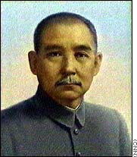
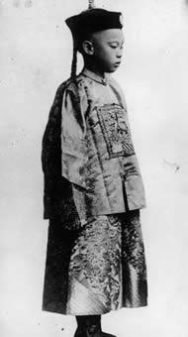
Kuomintang Power
1911 – Sun Yixian (Chinese Nationalist Movement) overthrows last emperor (Pu Yi)
Notes:
Pu Yi ascended the throne at 2 years 10 months

Slide 3
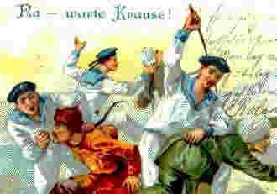
WWI – Allied Involvement
On the Allied side against Germany in WWI
Hope to regain lost lands from Germany

Slide 4
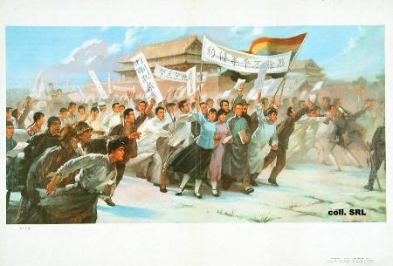
Betrayal
German territories given to Japan – not China
May 4, 1919 – May Fourth Movement – more people turn to communism

Slide 5
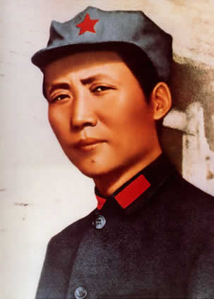
An Unlikely Alliance
Nationalists (Kuomintang) turn to Communists to help free China
Mao Zedong…

Slide 6
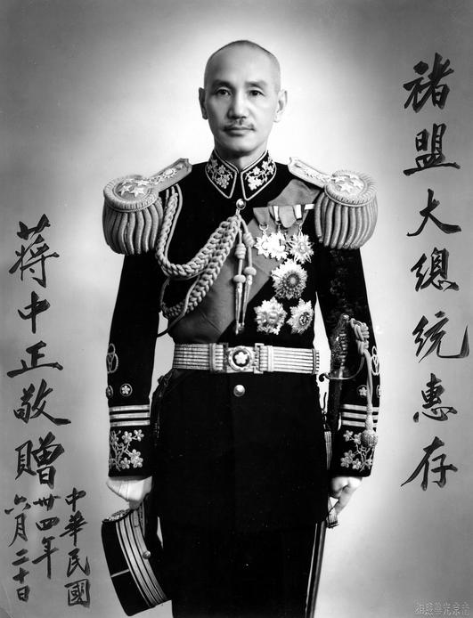
Death, & a Sharp Right Turn
Sun died in ’25, Chiang Kai-Shek the new leader.
Fierce anti-communist…
Notes:
Middle class background. Allied with bankers and businessmen (feared communism).
Does not inspire support among peasants.

Slide 7
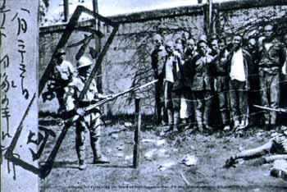
The Shanghai Massacre, 1927
As Europe leaves, Chiang consolidates power, turns on communists to be unquestioned leader
34 warlords eliminated, and finally communists are targeted
Notes:
Chiang Kai-Shek recognized as Chinese leader by Britain and the U.S. (not Soviet Union)
In Jiangxi, Mao's authoritative domination, especially that of the military force, was challenged by the Jiangxi branch of the CPC and military officers. Mao's opponents, among whom the most prominent was Li Wenlin, the founder of the CPC's branch and Red Army in Jiangxi, were against Mao's land policies and proposals to reform the local party branch and army leadership. Mao reacted first by accusing the opponents of opportunism and kulakism and then set off a series of systematic suppressions of them. Later the suppressions were turned into bloody physical elimination. It is reported that horrible forms of torture and killing took place. Jung Chang and Jon Halliday claim that victims were subjected to a red-hot gun-rod being rammed into the anus, and that there were many cases of cutting open the stomach and scooping out the heart.[6] The estimated number of the victims amounted to several thousands and could be as high as 186,000.[7] Through the so-called revolutionary terrorism, or red terrorism, Mao's authority and domination in Jiangxi was secured and reassured. However, this had left unforgettable scars on Mao's mind.
Will cause a 22 year civil war against the communists

Slide 8
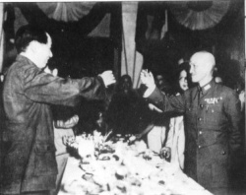
A New War
With common enemies gone, Chiang preemptively turns on Mao.
War rages through late 1920’s
Chiang and Mao in Better Days

Slide 9
1933 – The Long March
Cornered, Mao leads retreat for survival.
90K plus start it, 9K finish it.
Communism on life support
Notes:
Marches through peasant areas to gain support and keep one step ahead of pursuing Nationalists
Roundtrip from NY to SF over mountains and rivers
Need to get north to meet up with help from the Soviet Union

Slide 10
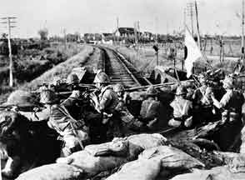
The Nationalists Distracted - 1933
Japanese invasion of Manchuria (northern China) combined with Depression allow Mao to rest & survive.
Japan attacking

Slide 11
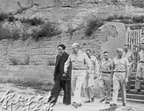
Mao Rebuilds Army in WWII
Under duress, Kuomintang and US use Mao as an ally.
Communists armed and building strength…
Mao with US Military in WWII
Notes:
More fighting and war preparation between the Communists and Nationalists than against the Japanese

Slide 12
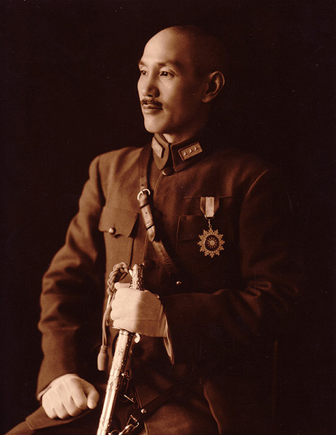
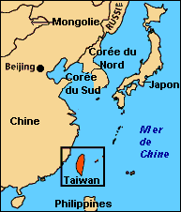
The Making of Taiwan… 1949
War weakens Kuomintang
Suffering turns people to Mao
Two Chinas today
Notes:
Republic of China – supported by the U.S.

Slide 13
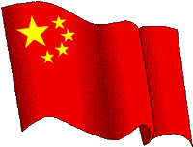
People’s Republic of China, 1949

Slide 14
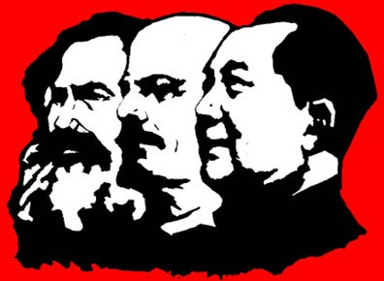
Maoism
Only violent revolution could undo China’s feudal past
Peasants would comprise the Red Army (too few industrial workers in China).
Sought to maintain an isolationist policy

Slide 15
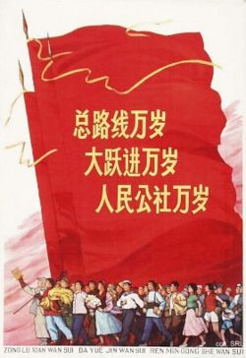
Communist Stability… 1955
Secure with the Korean War over, Mao tries to start communist reform
Redistributes land, nationalized industry, collective farms…
Notes:
Mao’s first political campaigns after founding the People’s Republic were land reform and the suppression of counter-revolutionaries, which centered on mass executions - often before organized crowds. These campaigns of mass repression targeted former KMT officials, businessmen, former employees of Western companies, intellectuals whose loyalty was suspect, and significant numbers of rural gentry.[9] The U.S. State department in 1976 estimated that there may have been a million killed in the land reform, 800,000 killed in the counterrevolutionary campaign.[10] Mao himself claimed a total of 700,000 killed during these early years (1949–53).[11] However, because there was a policy to select "at least one landlord, and usually several, in virtually every village for public execution",[12] 1 million deaths seems to be an absolute minimum, and many authors agree on a figure of between 2 million and 5 million dead.[13][14] In addition, at least 1.5 million people were sent to "reform through labor" camps (laogai).[15] Mao’s personal role in ordering mass executions is undeniable.[16] He defended these killings as necessary for the securing of power.[17]

Slide 16
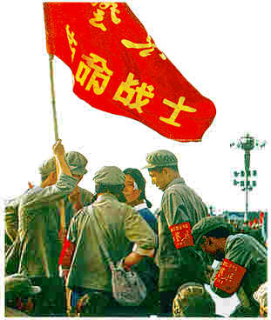
1956 - Hundred Flowers Campaign
Mao encourages Chinese to openly criticize the government and offer advice
Then he turns on the critics and massacres them.
Notes:
Programs pursued during this time include the Hundred Flowers Campaign, in which Mao indicated his supposed willingness to consider different opinions about how China should be governed. Given the freedom to express themselves, liberal and intellectual Chinese began opposing the Communist Party and questioning its leadership. This was initially tolerated and even encouraged. However, after a few months, Mao's government reversed its policy and persecuted those, totalling perhaps 500,000, who criticized, and were merely alleged to have criticized, the Party in what is called the Anti-Rightist Movement. Authors such as Jung Chang have alleged that the Hundred Flowers Campaign was merely a ruse to root out "dangerous" thinking.[citation needed] Others such as Dr Li Zhisui have suggested that Mao had initially seen the policy as a way of weakening those within his party who opposed him, but was surprised by the extent of criticism and the fact that it began to be directed at his own leadership.[citation needed] It was only then that he used it as a method of identifying and subsequently persecuting those critical of his government. The Hundred Flowers movement led to the condemnation, silencing, and death of many citizens, also linked to Mao's Anti-Rightist Movement, with death tolls possibly in the millions.

Slide 17
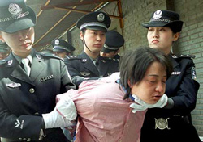
Laogai
“Re-education through labor”
Live the life of the peasant
Work people to death

Slide 18
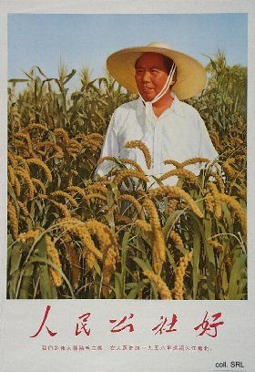
Great Leap Forward, 1958
Says failures from ’55 because he wasn’t bold enough…
Collectives build public works projects
Mao’s attempt to catch up with the rest of the world
Notes:
In January 1958, Mao launched the second Five Year Plan known as the Great Leap Forward, a plan intended as an alternative model for economic growth to the Soviet model focusing on heavy industry that was advocated by others in the party. Under this economic program, the relatively small agricultural collectives which had been formed to date were rapidly merged into far larger people's communes, and many of the peasants ordered to work on massive infrastructure projects and the small-scale production of iron and steel. All private food production was banned; livestock and farm implements were brought under collective ownership.
Under the Great Leap Forward, Mao and other party leaders ordered the implementation of a variety of unproven and unscientific new agricultural techniques by the new communes. Combined with the diversion of labour to steel production and infrastructure projects and the reduced personal incentives under a commune system this led to an approximately 15% drop in grain production in 1959 followed by further 10% reduction in 1960 and no recovery in 1961. In an effort to win favour with their superiors and avoid being purged, each layer in the party hierarchy exaggerated the amount of grain produced under them and based on the fabricated success, party cadres were ordered to requisition a disproportionately high amount of the true harvest for state use primarily in the cities and urban areas but also for export. The net result, which was compounded in some areas by drought and in others by floods, was that the rural peasants were not left enough to eat and many millions starved to death in what is thought to be the largest famine in human history. This famine was a direct cause of the death of tens of millions of Chinese peasants between 1959 and 1962. Further, many children who became emaciated and malnourished during years of hardship and struggle for survival, died shortly after the Great Leap Forward came to an end in 1962 (Spence, 553).
At LEAST 20 million die in the greatest famine in recorded history

Slide 19
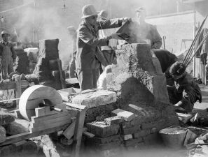
Fallout from the Great Leap
15-20 million starve to death as government makes steel but no food
One of the greatest tragedies of the 20th century.
Notes:
No incentive to work hard at farming or come up with novel ways to produce food
Backyard steel production a failure and diverts energy from farming
Some local Chinese ministers allow peasants to turn to more capitalist ways (small private markets, own homes)

Slide 20
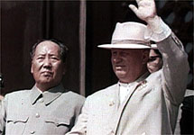
Sino-Soviet Split
As Khrushchev comes to power, Mao splits with the USSR
Foreign policy and border disputes
Notes:
Stalin was the elder leader of Marxism. When Stalin died, Mao should assume role as true world leader – not Kruschev.

Slide 21
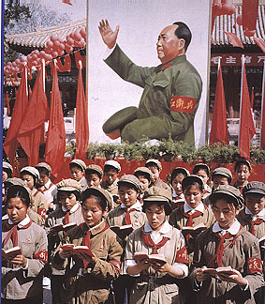
The Cultural Revolution, 1966
Mao thinks China’s past is holding reform back…
Little Red Book
All the past is destroyed by the Red Guard
Leaders killed
Notes:
Peasant was the hero – intellectual was the enemy
Following these events, other members of the Communist Party, including Liu Shaoqi and Deng Xiaoping, decided that Mao should be removed from actual power and only remain in a largely ceremonial and symbolic role. They attempted to marginalize Mao, and by 1959, Liu Shaoqi became State President, but Mao remained Chairman of the Communist Party of China. Liu and others began to look at the situation much more realistically, somewhat abandoning the idealism Mao wished for.
Facing the prospect of losing his place on the political stage, Mao responded to Liu and Deng's movements by launching the Cultural Revolution in 1966. The Cultural Revolution allowed Mao to circumvent the Communist hierarchy by giving power directly to the Red Guards, groups of young people, often teenagers, who set up their own tribunals. During the Cultural Revolution, Mao closed the schools in China and the young intellectuals living in cities were ordered to the countryside. They were forced to manufacture weapons for the Red Army. The Revolution led to the destruction of much of China's cultural heritage and the imprisonment of a huge number of Chinese citizens, as well as creating general economic and social chaos in the country. Millions of lives were ruined during this period, which is depicted by such Chinese films as To Live, The Blue Kite and Farewell My Concubine.
Mao eventually executes the Red Guard leaders to stop the Cultural Revolution by 1968
The Cult of Mao proved vital in starting the Cultural Revolution. China's youth had mostly been brought up during the Communist era, and they had been told to love Mao. Thus they were his greatest supporters. Their feelings for him were so strong that many followed his urge to challenge all established authority.
In October 1966, Mao's Quotations From Chairman Mao Tse-Tung, which was known as the Little Red Book was published. Party members were encouraged to carry a copy with them and possession was almost mandatory as a criterion for membership. Over the years, Mao's image became displayed almost everywhere, present in homes, offices and shops. His quotations were typographically emphasised by putting them in boldface or red type in even the most obscure writings.
After the Cultural Revolution, there are some people who still worship Mao in family altars or even temples for Mao.[

Slide 22
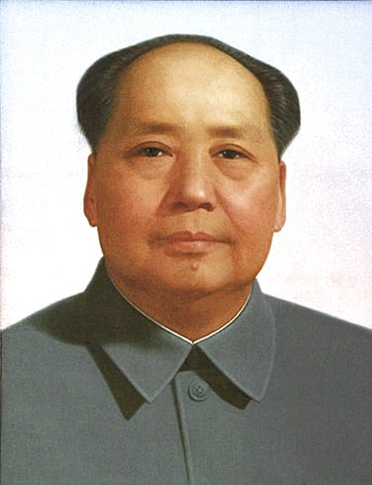
Mao Dies – 1976 (YAY!!!☺)
60-80 million dead due to his policies (worst ever tyrant…)
China agricultural and backward

Slide 23
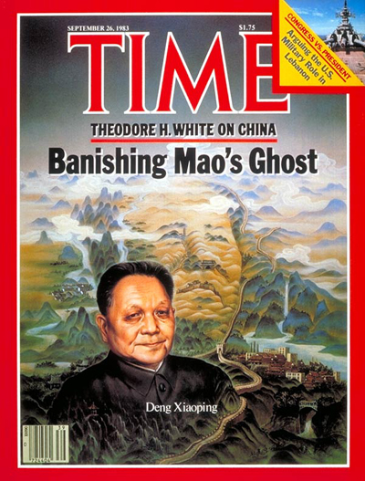
How to critique an Absolutist
Deng Xiaoping the new leader.
Focuses on transitioning from Agriculture to Industry
Illegal to criticize Mao or the Government

Slide 24
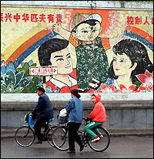
Market & Social Changes
One Child Policy
Capitalism slowly encouraged
Leads to greater prosperity in the 1990’s
Freedom???

Slide 25
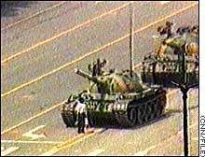
One too many Changes…
Tiananmen Square, April to June, 1989
100K students protest the government
Troops sent in to silence dissent
Numbers dead?

Slide 26
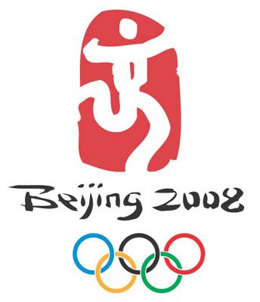
Today and the Future…
Hoping world forgets Tiananmen
Joined WTO and is market driven
Tremendous growth
New social problems w/o equality
Olympics in 2008

Slide 27
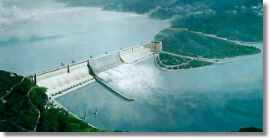
In the News…
3 Gorges Dam
Globalization’s impact on China
Political and Religious Repression still practiced
“Torture and Re-education”

Slide 28
The Way out of Poverty?
Capitalism!

