Slide 1
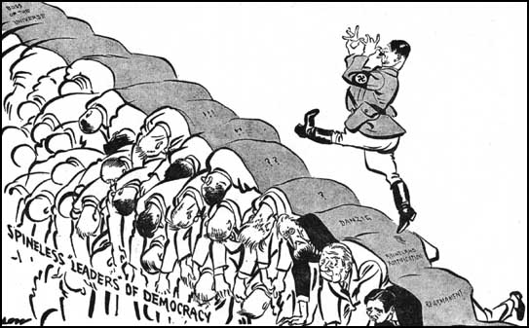
The Road to World War II
On your own copy of this picture, add labels to explain what the cartoonist suggests Hitler is doing?
Who are the other people in this picture and what does the cartoonist think of them?

Slide 2
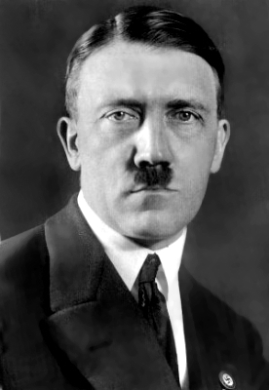
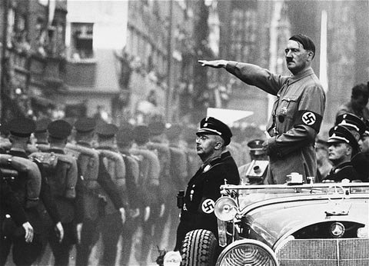
January 1933: Hitler became Chancellor of Germany

Slide 3
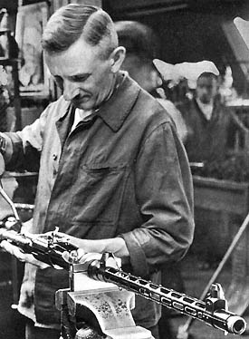
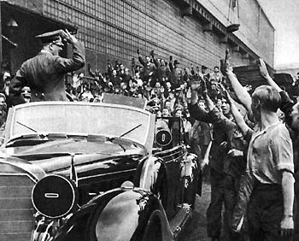
Hitler soon ordered a programme of rearming Germany
Hitler visits a factory and is enthusiastically greeted. Many Germans were grateful for jobs after the misery of he depression years.

Slide 4
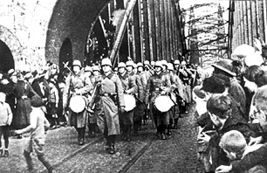
March 1936: German troops marched into the Rhineland
The Rhineland was a region of Germany that was ‘demilitarised’ after the Treaty of Versailles. Germany was not allowed to have troops in the region.
Hitler’s actions showed how he was willing to directly challenge the treaty.

Slide 5
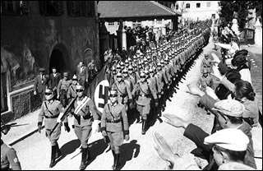
March 1938: Nazi Germany annexed Austria
Again, this went against the terms of the Treaty of Versailles which banned Germany from uniting with Austria.
However, the arrival of German troops was met with great enthusiasm by many Austrian people.

Slide 6
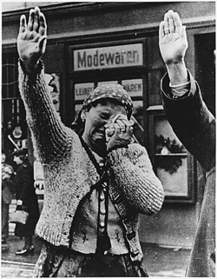
March 1939: Germany invaded Czechoslovakia
Hitler had ordered the occupation of a part of Czechoslovakia known as the Sudetenland (in October 1938). Many hoped that that this would be the last conquest of the Nazis.
However, in March 1939, he ordered his troops to take over the remainder of Czechoslovakia. This was the first aggressive step that suggested that a war in Europe would soon begin.

Slide 7
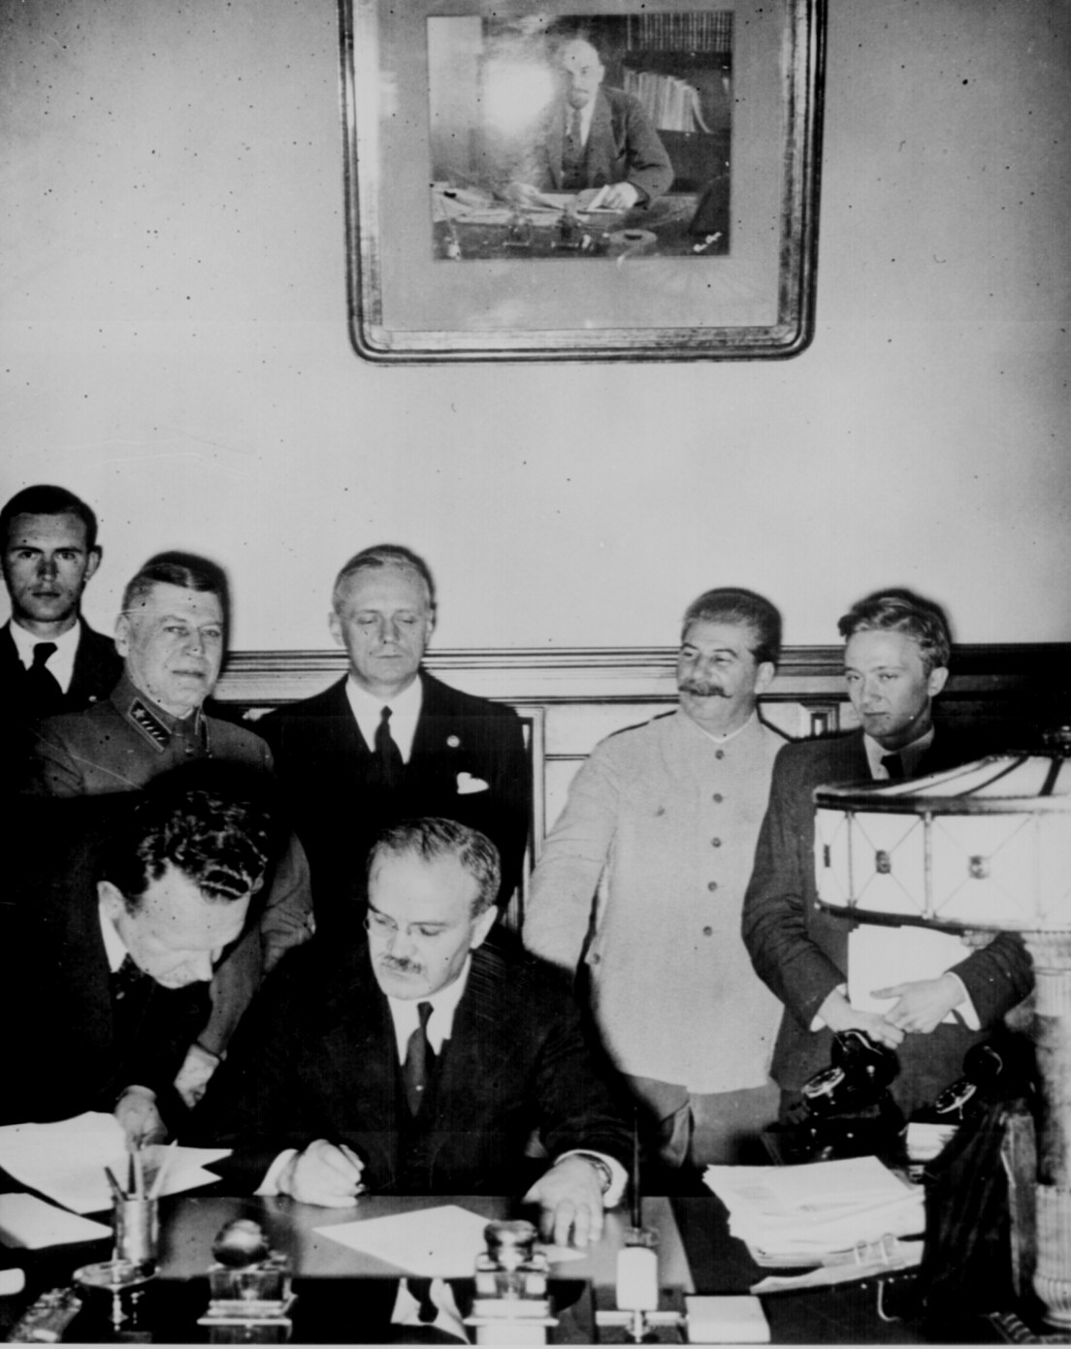
August 1939: Germany and Russia signed a non-aggression pact
Hitler and Stalin (the Russian leader) signed a ‘non-aggression pact’.
They promised that neither country would attack the other in the event of war.
As part of the deal, Hitler promised Stalin part of Poland, which he planned to invade soon.
This photo shows the Russian foreign minister signing the pact, whilst Stalin stands smiling in the background

Slide 8
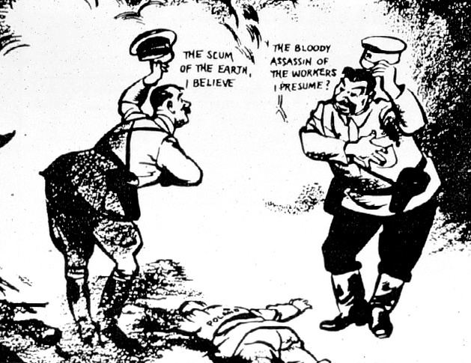
Stalin
Hitler
The non-aggression pact was surprising. Hitler and Stalin were seen as natural enemies.
When Hitler talked of taking over new land for Germany, many thought that he meant Russia.
Hitler also hated Communism, the form of government in Russia

Slide 9
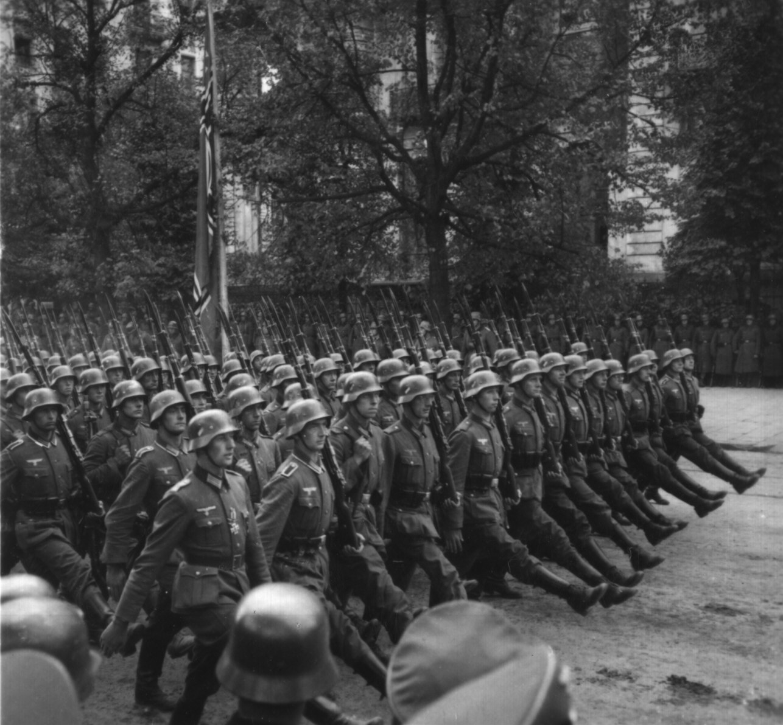
September 1939: Germany invaded Poland
But, the pact allowed Germany to march into Poland without fear of an attack from Russia.
On 3rd September 1939, Germany invaded Poland and started a War with Britain and France.
German troops marching into Warsaw, the capital of Poland.

Slide 10
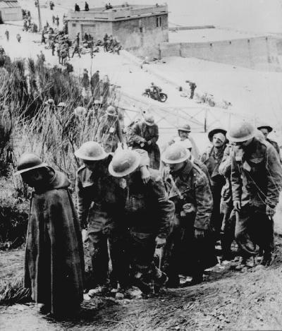
May 1940: Germany turned west and invaded France and the Netherlands
In May 1940, Germany used Blitzkrieg tactics to attack France and the Netherlands.
British troops were forced to retreat from the beaches of Dunkirk in northern France.
Captured British troops, May 1940

Slide 11
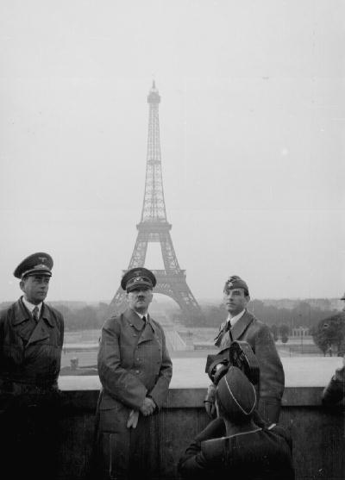
By June 1940, France had surrendered to the Germans
Britain now stood alone as the last remaining enemy of Hitler’s Germany in Western Europe.
Adolf Hitler tours Paris after his successful invasion.

Slide 12
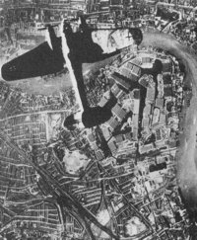
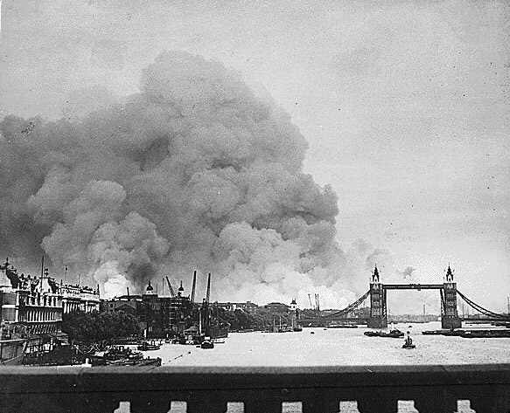
September 1940-May 1941: the Blitz
For the following nine months, the German air force (Luftwaffe) launched repeated bombing raids on British towns and cities. This was known as the BLITZ and was an attempt to bomb Britain into submission.

Slide 13
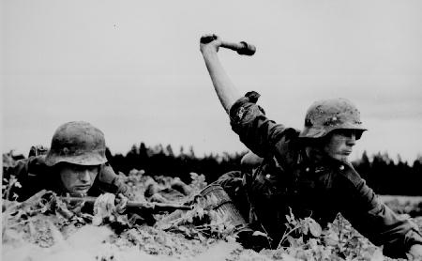
Operation Barbarossa, June 1941
But in May, 1941, Hitler ordered a change of tactics. He decided to halt the bombing of Britain and launch an attack against Russia. He betrayed Stalin and ignored the promises he had made.
This was a bold move that would prove to be an important turning point in the War.

Slide 14
Tasks
Firstly, use the timeline to indicate the order of events on your World War II maps.
Then answer the following questions:
In what ways did Hitler ignore the Treaty of Versailles?
At what stage do you think other countries should have attempted to stop Hitler by using force? Why do you think they did not?
How was Hitler able to take over Western Europe so quickly?
Why did he create problems for the German army by deciding to invade Russia?

